Slide 1

ROCKBUSTER STEALTH
Business Strategy 2020
Yusuf Salk

Slide 2

AGENDA
Introduction
Data Overview
Films and Categories
Customers and Countries
Recommendations

Slide 3
Introduction
Rockbuster Stealth LLC is a movie rental company that used to have stores around the world. Facing stiff competition from streaming services such as Netflix and Amazon Prime, the Rockbuster Stealth management team is planning to use its existing movie licenses to launch an online video rental service in order to stay competitive.

Slide 4
DATA OVERVIEW
Number of Films
1000
Number of Genres
17
Release Year
2006
Number of Customer
599
Rental Duration
3 to 7 Days
Rental Rate
$0.99 to $4.99
Total Revenue
$61,312
MPAA Ratings
PG, R, G, NC-17, PG-13

Slide 5



Films and Categories

Slide 6

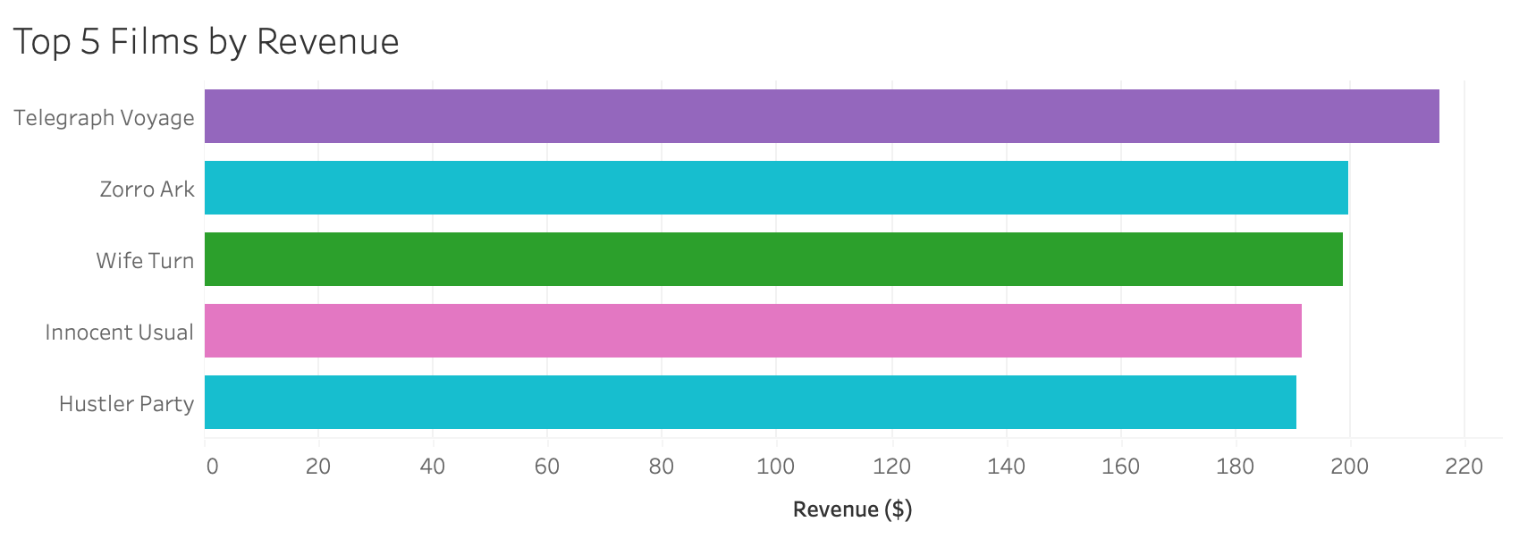
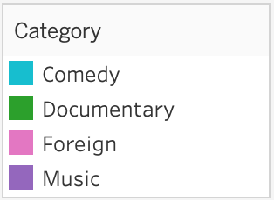
Total revenue of the top 5 films is $996.72
They are divided into 4 different categories
Two of them are in the comedy category
The rental rate for all the top 5 films is $4.99

Slide 7
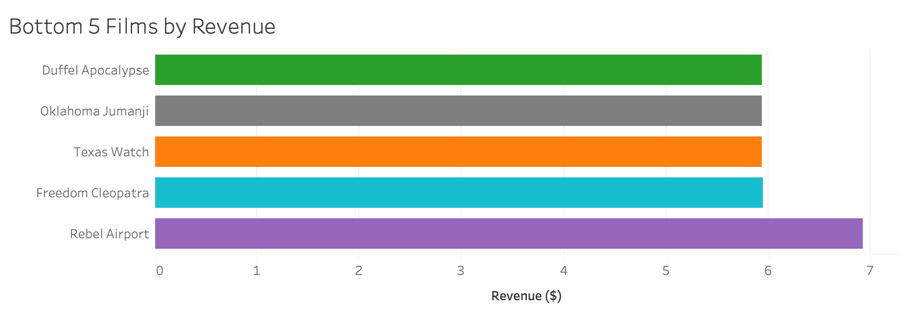
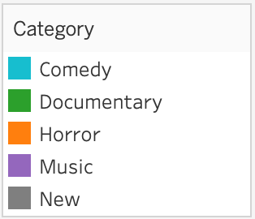
Total revenue of the bottom 5 films is $30.70
They are divided into 5 different categories
The rental rate for all the bottom 5 films is $0.99
There is a positive correlation between the rental rate and revenue

Slide 8
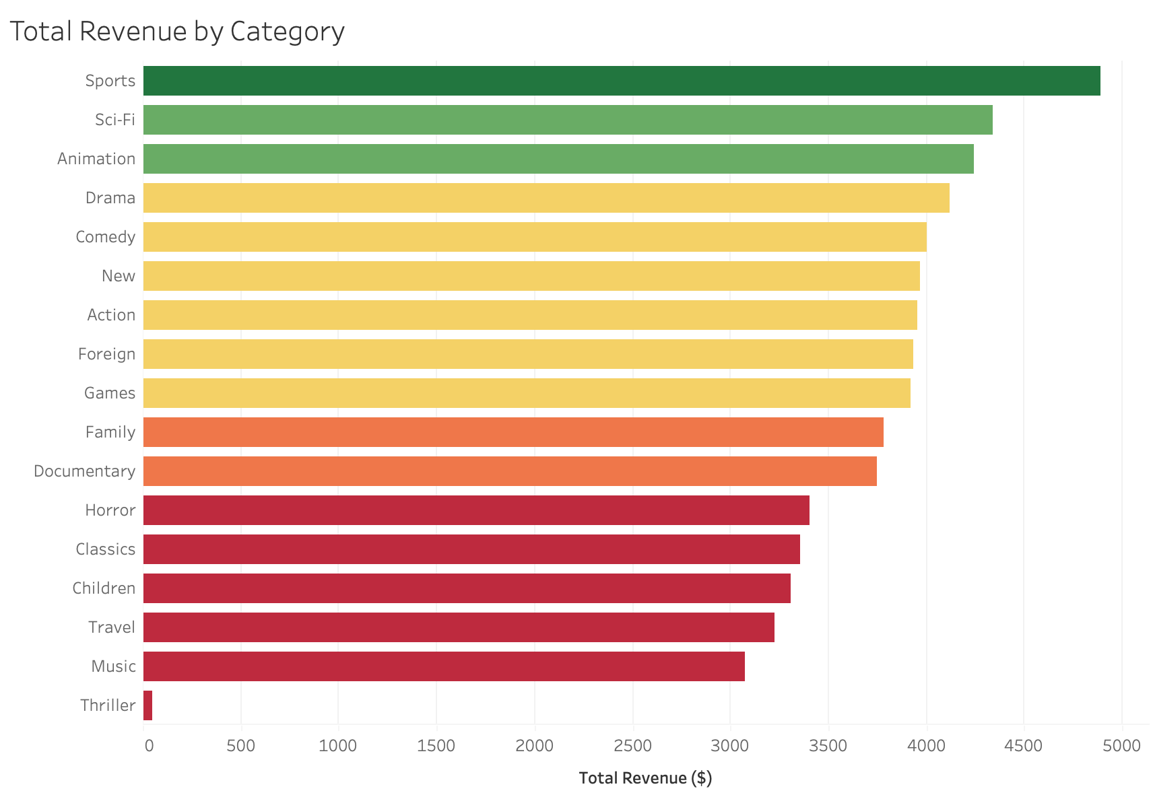
Sports category has the highest total revenue. It is followed by Sci-fi and Animation, respectively.
The category of films with the lowest revenue is Thriller.

Slide 9
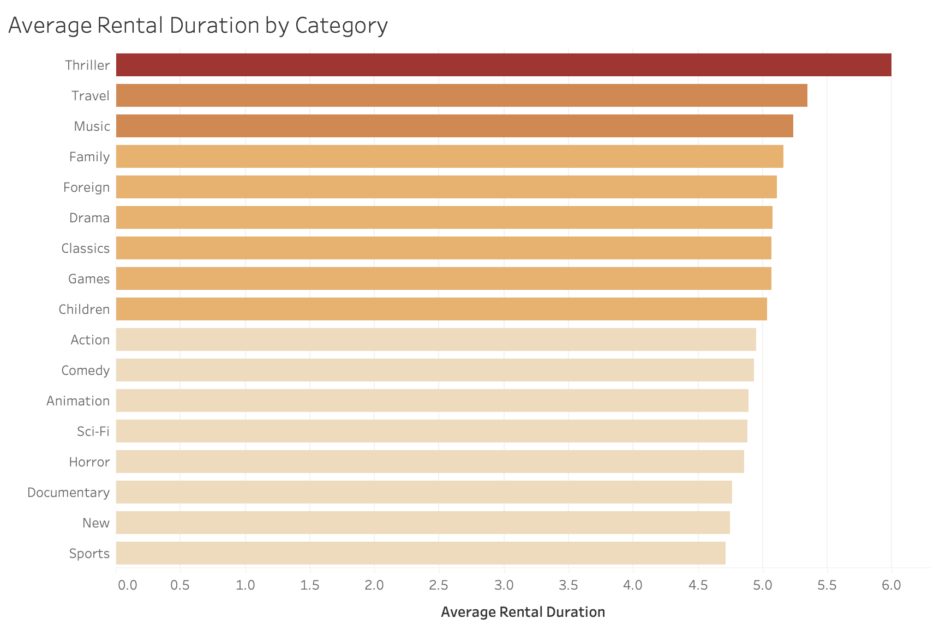
Thriller category has the longest average rental duration whereas has the lowest revenue.
Sports category has the shortest average rental duration whilst has the highest revenue.

Slide 10

CUSTOMERS AND COUNTRIES

Slide 11
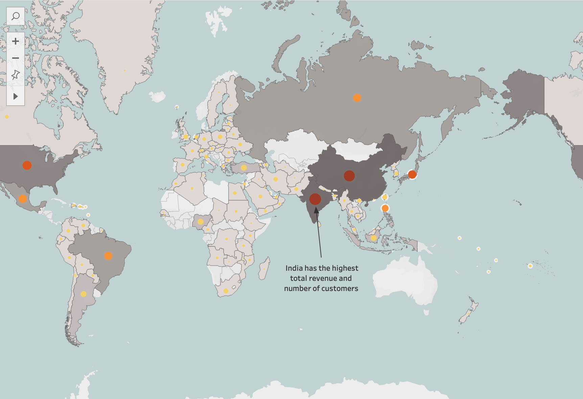
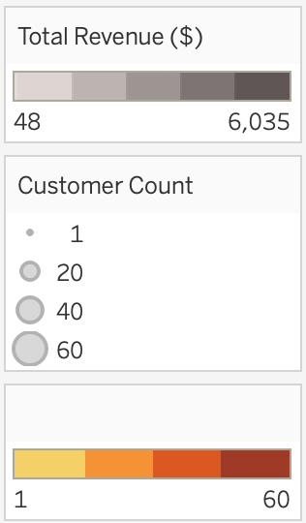
WHERE DOES THE HIGHEST REVENUE AND NUMBER OF CUSTOMERS COME FROM?
If the country has a large number of customers, its revenue is also high.

Slide 12
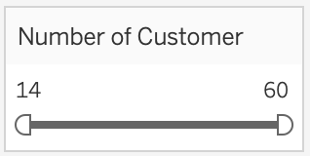
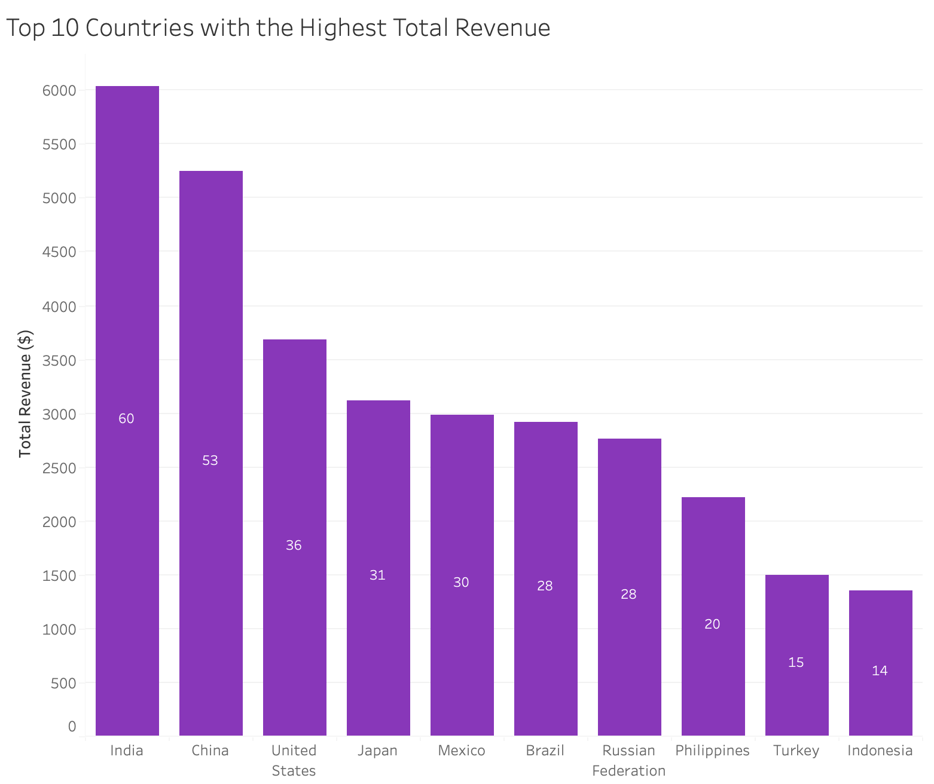
India has the highest number of customers and total revenue.
It is followed by China and United States.
There is a positive correlation between the number of customers and revenue.

Slide 13
Top 10 High Lifetime Customers
CUSTOMER NAME | COUNTRY | CITY | TOTAL AMOUNT PAID ($)
Eleanor Hunt | Runion | Saint-Denis | 211.55
Karl Seal | United States | Cape Coral | 208.58
Marion Snyder | Brazil | Santa Brbara dOeste | 194.61
Rhonda Kennedy | Netherlands | Apeldoorn | 191.62
Clara Shaw | Belarus | Molodetno | 189.60
Tommy Collazo | Iran | Qomsheh | 183.63
Ana Bradley | United States | Memphis | 167.67
Curtis Irby | Canada | Richmond Hill | 167.62
Marcia Dean | Philippines | Tanza | 166.61
Mike Way | India | Valparai | 162.67

Slide 14
Target top countries by revenue to increase total income, for example India, China, United States
Expand inventory in the highest revenue categories, such as Sports, Sci-Fi, Animation
All films in the current inventory are in English. Add new films in other languages to reach more potential customers
Reward high lifetime customers
Develop a loyalty program to gain more high lifetime customers
Recommendations

Slide 15

THANK YOU!
Click for Tableau Visuals

